Slide 1


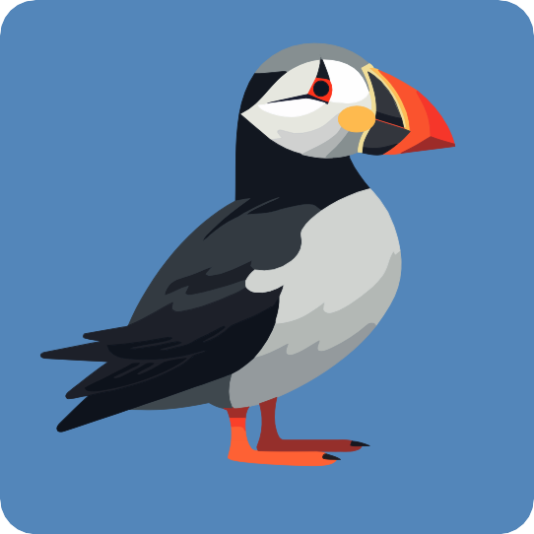

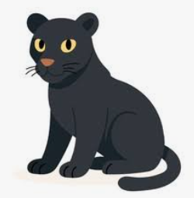
WELCOME TO
YEAR TWO
Thorndown Primary School Information Session Autumn Term 2026

Slide 2
School Values
Achievement
Well - Being
Opportunity
Children will have access to a fun and engaging curriculum,
Children will be supported to develop their emotional well-being through their curriculum, opportunities for play and life at school.
Children will be provided with opportunities to expand their understanding of the world.
Children will be given the opportunity to succeed.
Children will be given the tools to succeed.

Slide 3

A typical Day
8.40 - 9.00
Morning Work
9.10 - 9.30
SPaG
Breaktime
Our breaktime is at 10.45
We have breaktime on the field with the rest of the school. Free fruit is provided or your child can bring a piece of fruit or veg from home.
Lunchtime
Our lunchtime is at 12.00. During lunchtime children can access OPAL
English
9.30-10.30
10.30 - 10.45
Assembly
Break
10.45 - 11.00
Maths
11.00 - 12.00
12.00 - 1.00
Lunch

Slide 4

A typical day
1.00 - 1.15
Fluency
1.15 - 2.00
Reading
2.00 - 2.30
Foundation Subject
2.30 - 3.00
Foundation Subject/P.E
3.00- 3.15
Story

Slide 5
PE
PE KIT
Thorndown PE kit is a white t-shirt with navy or black shorts. In winter, children will need a tracksuit to keep warm during outdoor PE and this should be in dark, plain colours without logos. For safety, please note that tracksuit tops without hoods are preferable. No jewellery should be worn and long hair should be tied back. We also stick by the national guidance that earrings should not be taped or covered.
OUR PE DAYS
 | Indoor | Outdoor
Puffins | Friday | Tuesday
Panther | Tuesday | Thursday
Koala | Wednesday | Friday

Slide 6
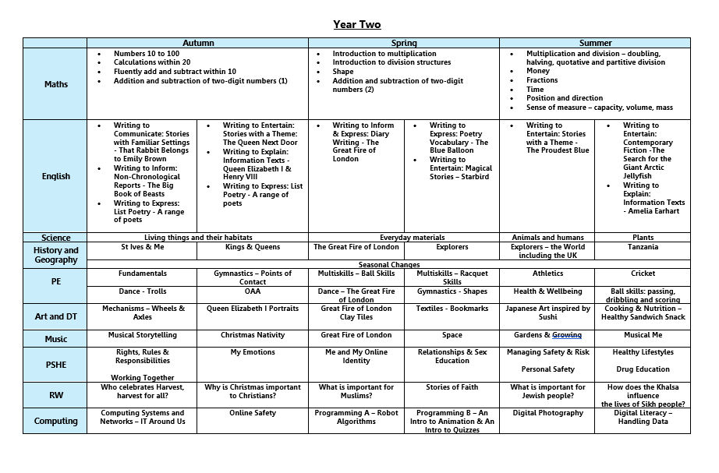
OUR LEARNING
An e-copy of this diagram will be
sent out to you along with these presentation slides

Slide 7

OUR MATHS LEARNING

Slide 8
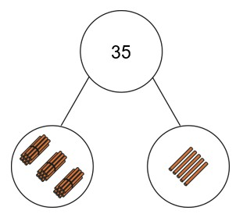
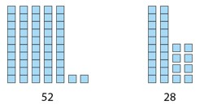
Maths Curriculum
Autumn term
· Place Value
· Addition
· Fluency—learning key number facts

Slide 9


OUR ENGLISH LEARNING

Slide 10


Reading Lessons
The children have whole class reading lessons. These involve sharing texts together and exploring the comprehension of reading. The teacher models good use of intonation, fluency, volume and expression and children pick up good reading styles.
We teach the children to recap, reflect, discuss, visualise, echo read, skim and scan.
Once a fortnight your child will read with the teacher as part of a small group. The text will be linked to their current reading ability.

Slide 11


Reading at Home
Your child will continue to bring home a reading book. As they progress and once they have reached lime green books, they will become a free reader, where they can choose a longer text from the Discovery Suite appropriate to their age group.
Your child wlll be given the opportunity to change their reading book on Mondays and Thursdays. We encourage the children to read the same book multiple times to develop their reading fluency.
How can you help reading at home?
Please read with your child every day and support them to log what they have read. Just 10 minutes a day is 60 hours a year. The benefits to your child are huge!
Children will be rewarded for regular reading at home.
White

Slide 12


Slide 13
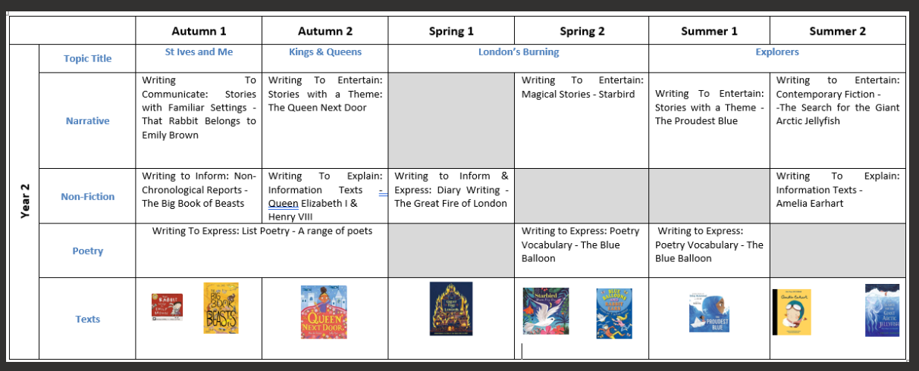
English Curriculum
Year 2
In Year 2 the children will take part in SPAG (Spelling, Punctuation & Grammar) sessions in school. This is an opportunity to learn new spelling rules and recap all of their Phonics learning from Year One. There is a strong focus on the use of correct standard English.

Slide 14
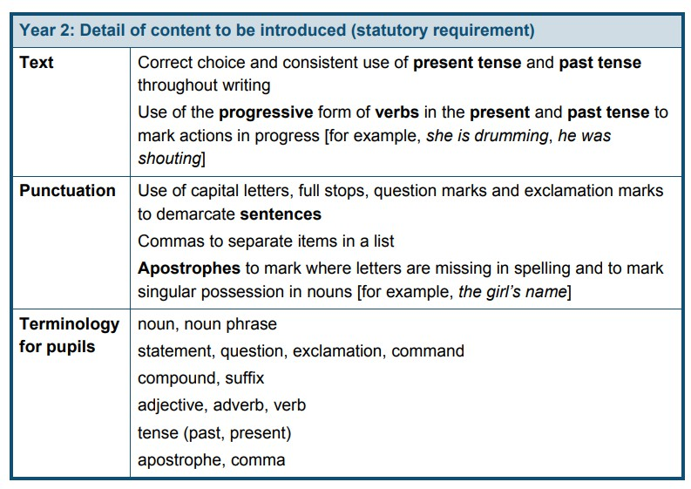
SPAG
SPaG stands for Spelling, Punctuation and Grammar and is a key part of our English curriculum in Year Two.
This is taught daily for around 25 minutes.
The table below has a summary of the taught content. We also work on a range of spelling rules.
Alongside this we will also learn to spell the Year Two common exception words and there will be some revision of the Year One words for those who are not yet secure.
We will inform you of the words we are working on by sending home weekly SPaG homework. If you wish to send in your child’s response to this, please do!
White

Slide 15
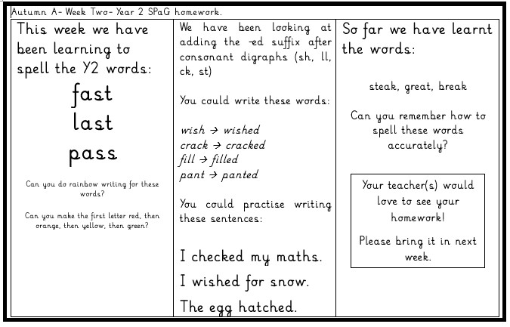
SPAG
This is what the homework looks like:
White

Slide 16
Phonics
In order to promote accurate spelling, we will continue to recap learnt phonics sounds during our SPaG sessions.
Some children will continue to learn Phonics with Mrs Emberton or Mrs Garwood.
If your child is in Puffins class but is not involved in these Phonics sessions, they will join Koalas or Panthers for SPaG.
If your child did not pass the Year One Phonics Screening they will repeat this check in June.
For further support on how you can help your child, please chat to your child’s class teacher(s).
White

Slide 17
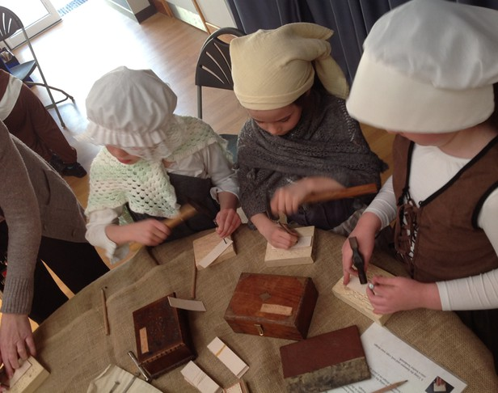
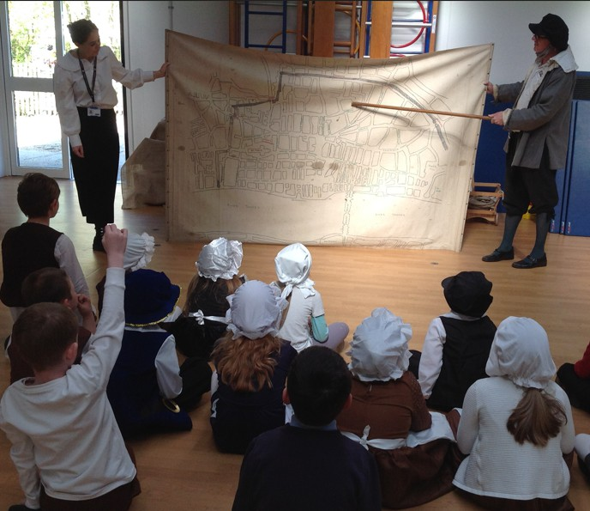
VISITORS IN
-History Off the Page- Great Fire of London,
-Mrs Zaman - linked to 'The Proudest Blue' text

Slide 18
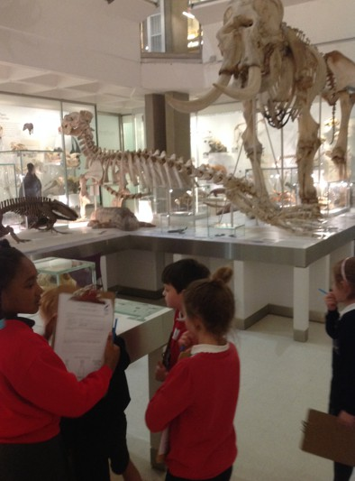

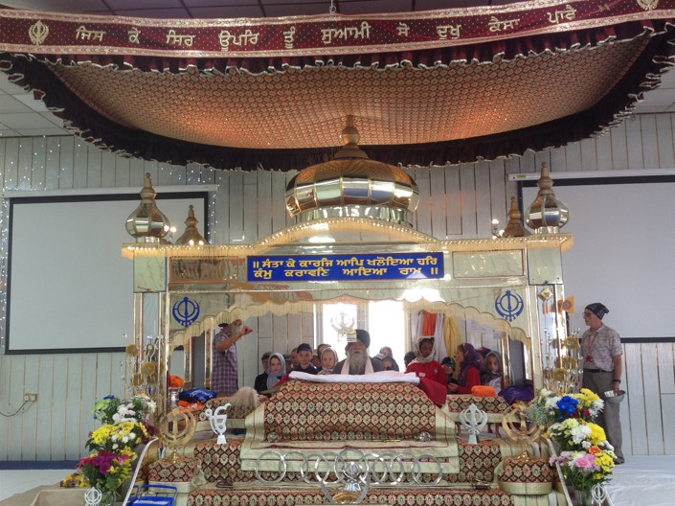
VISITS OUT
This month we will visit St Ives for a guided history walk with staff from the Norris Museum.
We will also cover some of our geography objectives during this trip.
In April, we will visit the Zoology Museum and the Fitzwilliam Museum in Cambridge.
In June, will visit the Sikh Gurdwara in Peterborough during our RW learning about Sikhism.
In July we will take part in the Year Two Music Festival.
We are always grateful for help and support on our educational visits.

Slide 19






DO YOU HAVE ANY QUESTIONS
?

