Slide 1








WELCOME TO
YEAR ONE
Thorndown Primary School Information Session Autumn Term 2025

Slide 2
School Values
Achievement
Well - Being
Opportunity
Children will have access to a fun and engaging curriculum,
Children will be supported to develop their emotional well-being through their curriculum, opportunities for play and life at school.
Children will be provided with opportunities to expand their understanding of the world.
Children will be given the opportunity to succeed.
Children will be given the tools to succeed.

Slide 3
Volunteering
We love having parents and carers involved in our school community! There are lots of ways you can support our learning:
📖 Reading Volunteers
Come in and read with individual children – a wonderful way to support comprehension skills and build confidence.
🎨🧪🧵 Share Your Skills
Do you have a hobby, job, or talent that connects with our topics?
We’d love to hear from you! Whether it’s cooking, art, science or anything else – your skills can bring learning to life.
Please contact Mrs Dunsdon or catch your child’s class teacher at the end of the day.
🚌 School Trips & Special Events
We always need extra hands for trips, special days, and enrichment activities.
(Mrs Cook will be in touch throughout the year with opportunities to get involved).
White

Slide 4

A typical Day
8.40 - 9.00
Morning Work
9.00 - 9.30
Phonics
Group Work and Provision
Children will experience whole class input followed by focused group work and those that aren’t doing group work will have access to the provision indoors and outdoors.
Lunchtime
Our lunchtime is at 12pm.
During lunchtime children can access OPAL
Maths/English
9.30 - 10.30
10.30 - 10.45
Fluency
English/Maths
10.45 - 12.00
Topic/Forest School/PE/PSHE
13.00 -14.00
14.00 - 15.00
Busy Learning & Reading
15.00 - 15.15
Story time

Slide 5
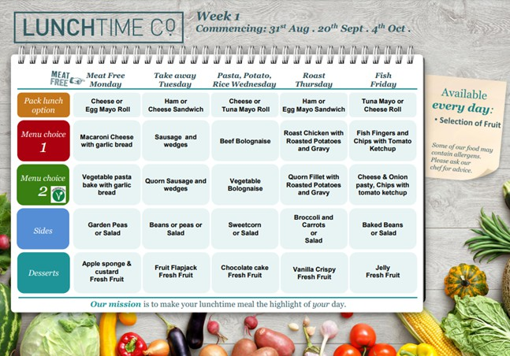
LUNCHTIMES
Year 1 children go straight in for lunch and for those having school dinner, they choose their meal at the counter.
The menu choices are shared with the children before lunchtime but it would be really helpful if you were also able to discuss the school dinner menu options with your child at home to help them be more prepared and make a choice.
The children are also expected to carry their own
plates and tidy them away when they finished so the more you can encourage
have these
independent skills at home the easier they will find it in school.

Slide 6
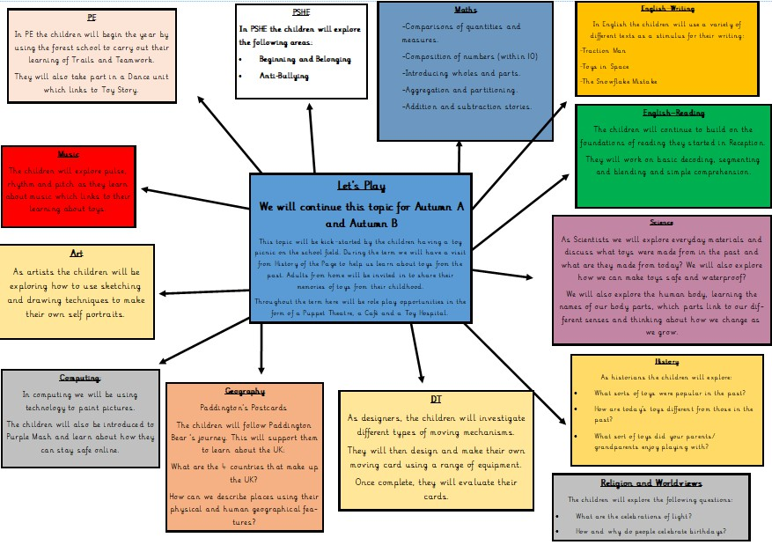
OUR LEARNING

Slide 7
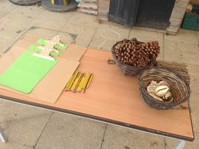
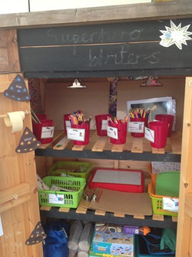
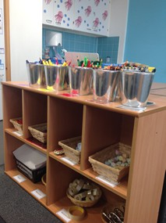
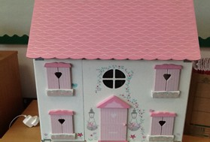
OUR LEARNING
The Environment
Each classroom has resources available for the children to access during enhanced provision time.
You may hear your child call this ‘Busy Learning’. This includes role-play areas, construction, toys and craft materials.
To enable the children to continue their physical development, carefully planned gross motor and fine motor activities are always available.
The outdoor area is also open during enhanced provision time and the children are able to free-flow between the inside and outside areas.

Slide 8
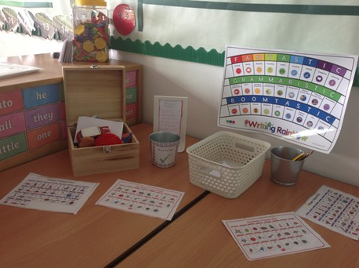
MUST DO JOBS
During each session of enhanced provision the children will have ‘must-do jobs’ which have to be completed. These link closely to the learning they are taking part in during their focus group time and allow them the opportunity to apply their learning more independently.
The amount of these compulsory tasks and the complexity of the tasks will increase as the year progresses.

Slide 9




PE (INDOOR)

Slide 10




PE
Thorndown PE kit is a white t-shirt with navy or black shorts. In winter, children will need a tracksuit to keep warm during outdoor PE and this should be in dark, plain colours without logos.
For safety, please note that tracksuit tops without hoods are preferable.
No jewellery should be worn and long hair should be tied back. We also stick by the national guidance that earrings should not be taped or covered.

Slide 11
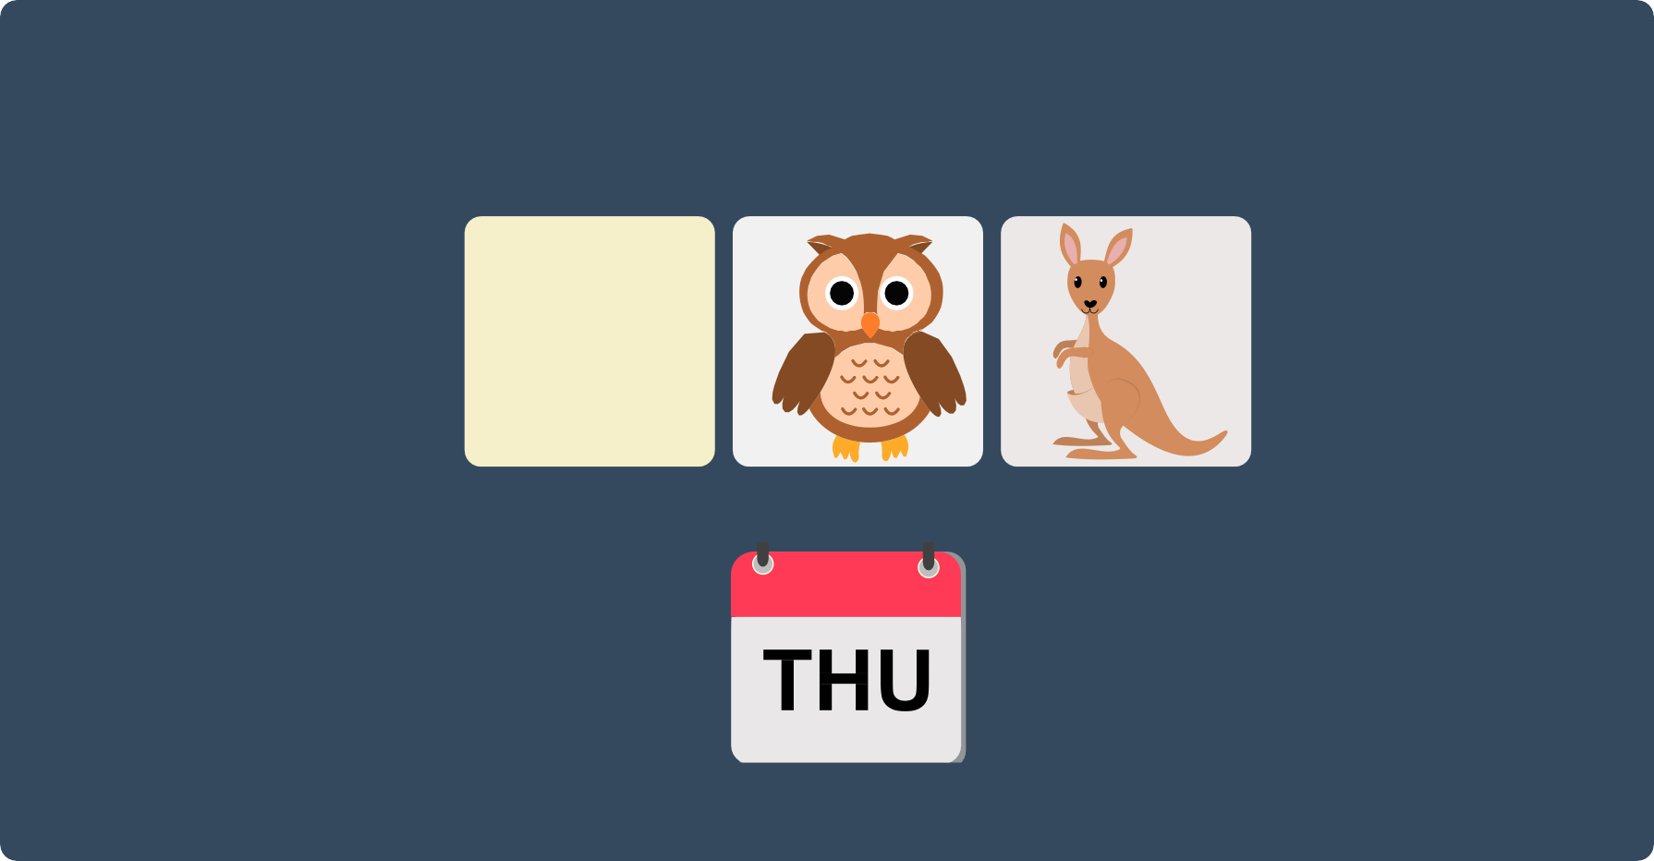
Forest School

Slide 12




Forest School
Your child will need:
waterproof cothing (puddle suit, trousers etc.) wellingtons
spare clothes in a bag
ALL items must be clearly named. These items can stay in school.

Slide 13
PSHE
COVERAGE
AUTUMN SPRING
SRE
SUMMER
Learning Objectives:
Beginning and Belonging
be able to recognise names for the main external parts of the body.
be able to name the sexual parts using colloquial and occasionally scientific words.
be able to describe what their bodies can do and understand how amazing their body is.
show some understanding that their body belongs to them.
be able to describe some basic personal hygiene routines and understand how these can prevent the spread of disease.
Diversity and Communities
Personal Safety
Sex and Relationships Education
Family and Friends
Managing Change

Slide 14

OUR MATHS LEARNING

Slide 15
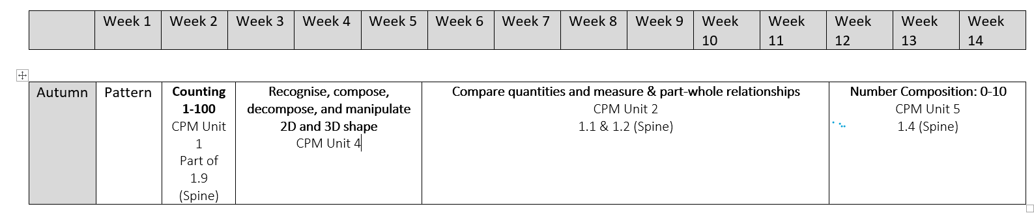
Maths Curriculum

Slide 16
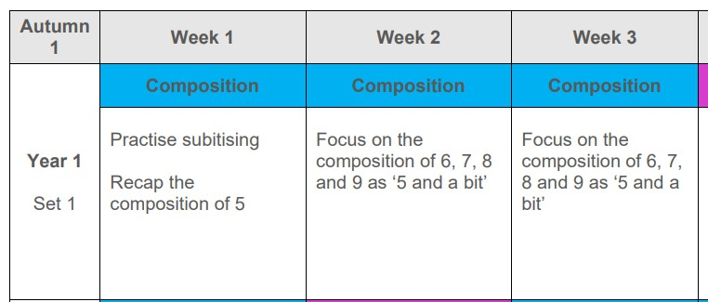
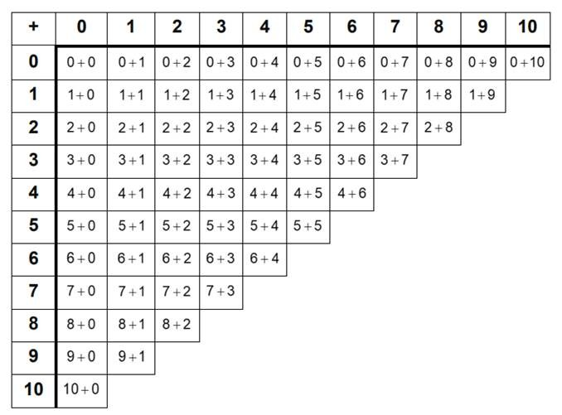
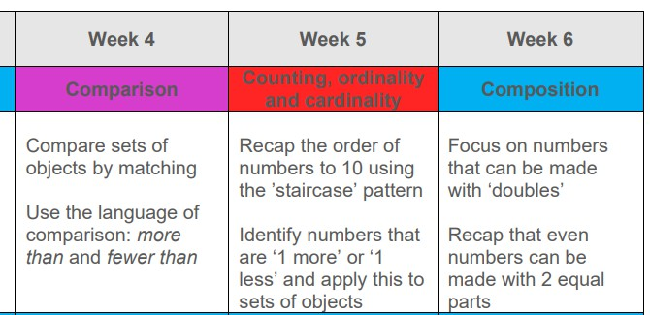
FLUENCY

Slide 17


OUR ENGLISH LEARNING

Slide 18
Reading Lessons
During the Autumn Term the children will read with an adult in school individually twice a week.
As the year progresses they will begin to take part in guided reading sessions, initially as a small group and by the end of the year, as a whole class. These sessions involve sharing texts together and exploring the comprehension of reading.
We focus on the following skills: prediction, retrieval, summarising, making choices, sequencing, inference, explaining, exploring vocabulary

Slide 19
Phonics
In Year 1 the children will continue to take part in daily phonics sessions in school. This is an opportunity to revisit and review the sounds that they have learnt in Reception and explore how these make up part of a wider sound family.
When learning phonics in school we use the pure sounds and this helps the children when it comes to blending in their reading.
In June the children will complete a Phonics screening check.
White

Slide 20


Reading at Home
Your child will continue to bring home a reading book. As they progress and once they have reached lime green books, they will become a free reader, where they can choose a longer text from the Discovery Suite appropriate to their age group.
How can you help reading at home?
Please read with your child every day and support them to log what they have read. Just 10 minutes a day is 60 hours a year. The benefits to your child are huge!
Children will be rewarded for regular reading at home.
White

Slide 21


Slide 22
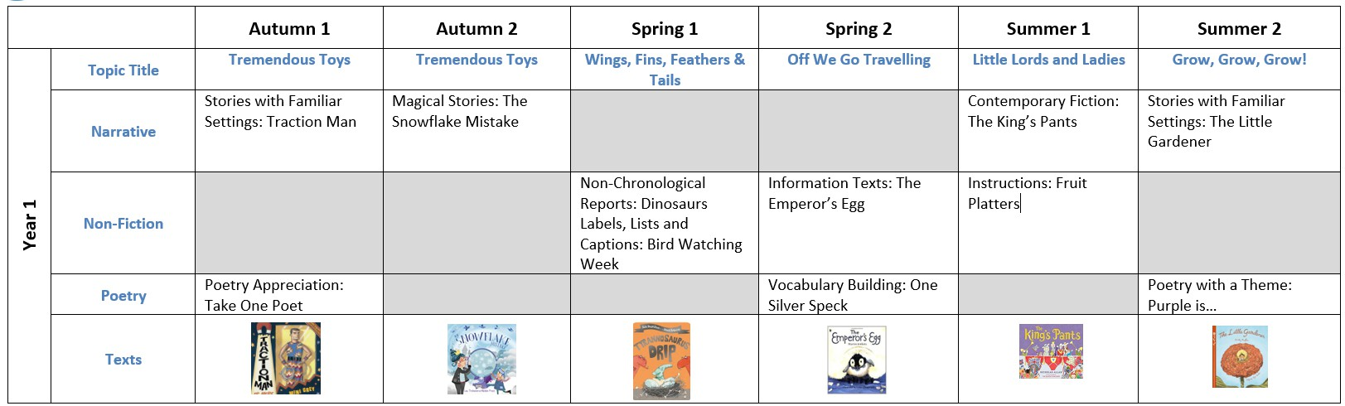
English Curriculum
Year 1

Slide 23
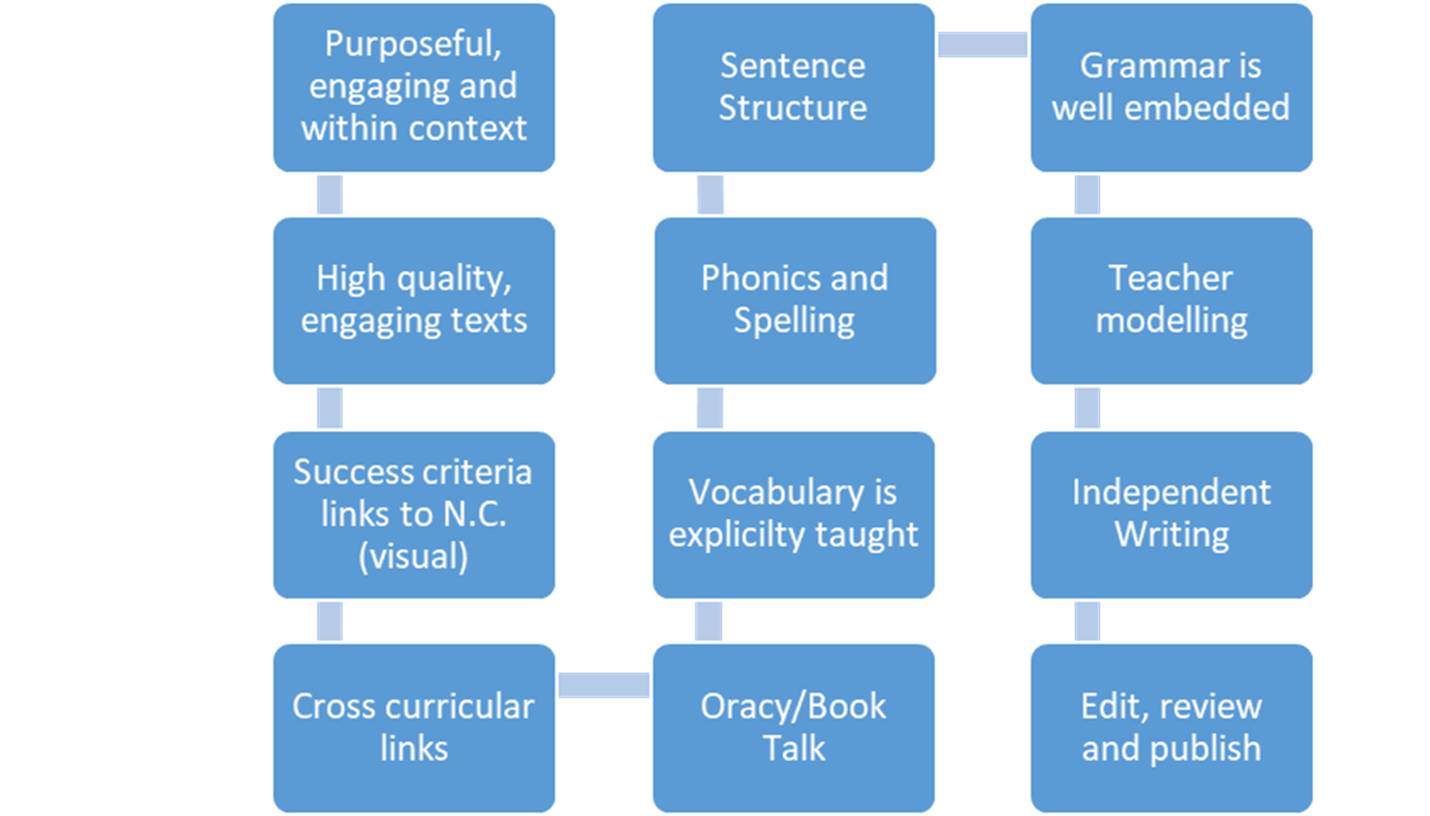
This is what the journey through a high quality unit of writing looks like at Thorndown

Slide 24
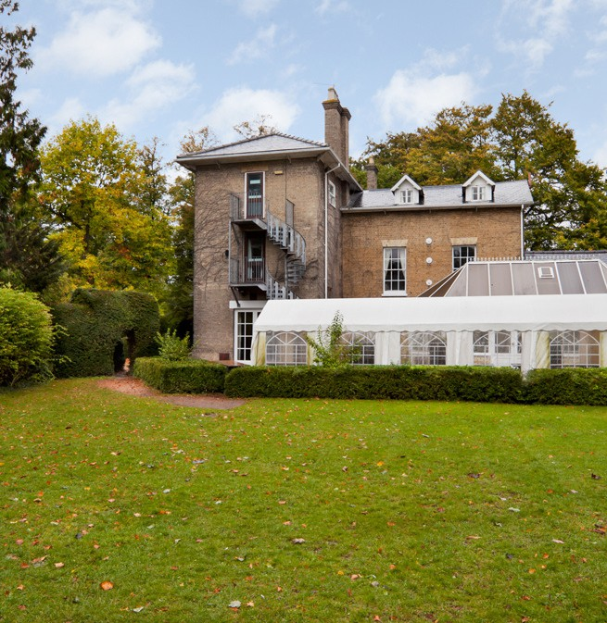
VISITORS IN
As part of our opportunity value, the currciulum will be enriched with visitors into school.
History Off the Page - Toys

Slide 25
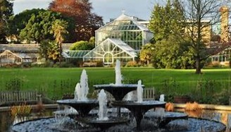
VISITS OUT
Walk to the Church in St.
Ives
Botanic Gardens, Cambridge

Slide 26

SEESAW
To share our practical hands on learning and for school to communicate with our families we will continue to use Seesaw.
If you need to speak to your child’s class teacher please approach them of a morning on the classroom door or email the school office to arrange an appointment.
Please use the code to activiate your child’s account. We will be using this on Monday 8th September 2025, so we kindly ask that you activate it by SUnday 7th September 2025.

Slide 27


OPaL
Our school is proud to be an OPAL (Outdoor Play and Learning) school, placing play at the centre of break and lunchtimes. Play supports children’s social, emotional, and physical development while building creativity, resilience, and problem-solving skills. Children are free to choose how and where to play, with access to a wide range of equipment and dedicated zones.
To ensure all children can take part, they must come prepared for all weather. A coat should be brought every day and wellington boots will be needed as the seasons change (we will provide more information on this) so that all areas remain accessible.
If providing these items is difficult, please contact the school for support.

Slide 28

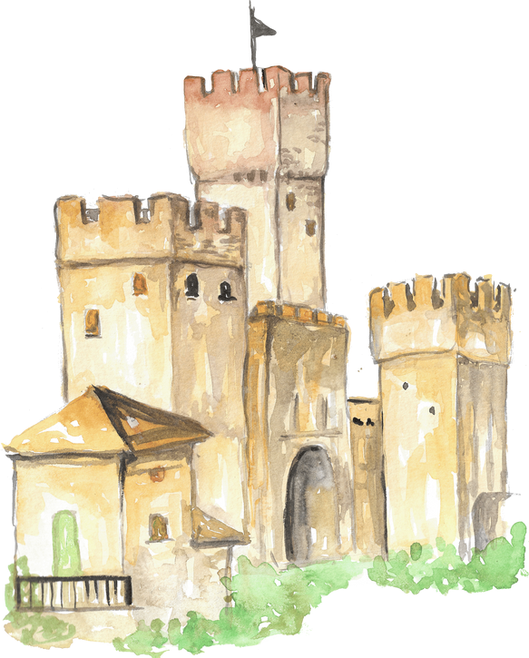


DO YOU HAVE ANY QUESTIONS
?

